Slide 1
Process and Tool Impact
CTT IDs

Slide 2
Activity ID Processes and Tools
APIs (Tray, Allocadia, Eloqua, VDC Tools)
Create SFDC Campaigns
Mandatory field for Lead Creation
Visibility to LDR of Activity Name and Description
Values for Eloqua Picklists of AOJs
Tray processing flows
ABX 0 Opportunity alignment
Landing Page Metadata
Ctm.js logic
Lead Routing in SFDC
Alignment to Conversica Campaigns
Mandatory field for manual upload process
Mandatory field for event integrations
Data attributes captured in CDF and ADF – Unknown Impact

Slide 3
Impacts
Salesforce
Demand Intake Tool
Tray.io
Eloqua
Allocadia
CDF
Reporting
Impacted Teams
Owner
Daryl Thomas
Amanda Chenery
Daryl Thomas
Kim Braithwaite
Dharmesh Chopra
Dharmesh Chopra
Amanda Gulino
✓
✓
✓
✓
✗
✓
✓
IT Impact
Salesforce Campaigns created aligned to Activity ID and Offer ID
Activity and Drive To ID mandatory fields
Validation on IDs dependent on intake type
TBA
TBA
TBA
TBA
CTTG integration for ID Validation
Major Changes
Lead Generation Mandatory field for Activity ID
Derivation of business category using DTID information
Visual for LDR for Offer and Campaign Information – some fields from Tray and some directly from CTT
Creation of SFDC Campaigns based on Activity and Offer IDs
Alignment of leads to VDC and SFDC Campaigns base on Activity ID
Reporting for CTT values from Tray
Dependencies
CDC Tools
Tray
DIT
Eloqua
Tray
None
Eloqua
Tray
Eloqua

Slide 4
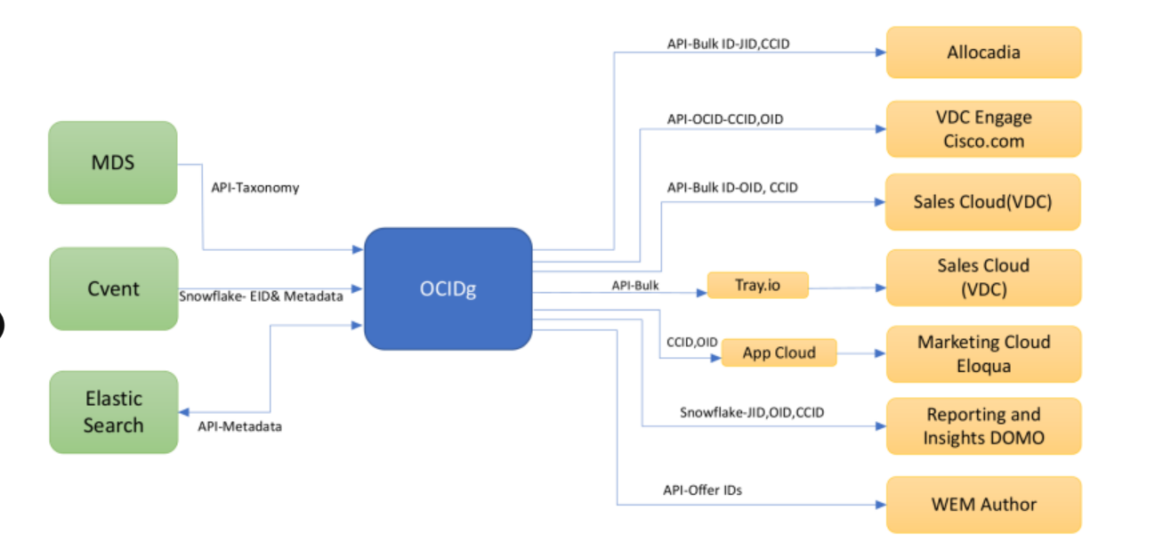
CTT Integrations

Slide 5
Campaign Tagging & Tracking Attributes
Activity ID
Offer ID
Drive To ID
Activity ID
Offer ID
DTID
Requested By
Offer Type
Vehicle Type
Campaign
Business Entity
Vehicle Name
Program
Offer Name
Sub Vehicle/Vendor
Activity Name
Description
Description
Description
Language
Requested By
Live Date
Intended Vertical
Status
Expiration Date
Live Date
Expiration Date

Slide 6

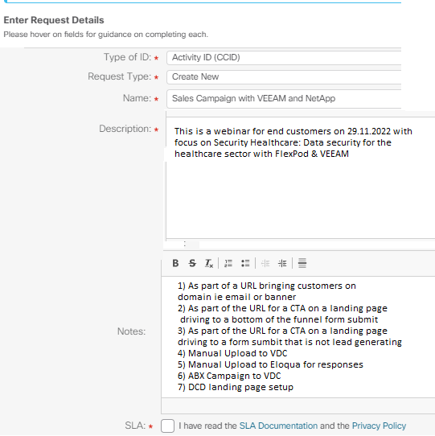


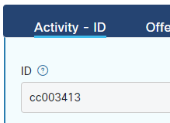
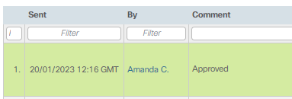
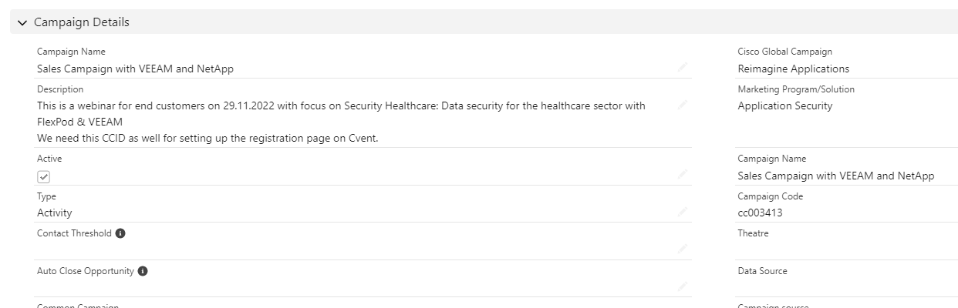
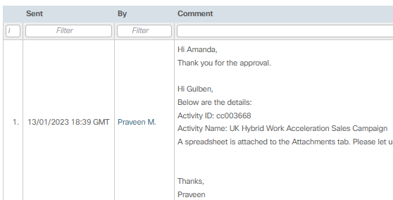
Legend
Manual
Activity ID Creation
Automated
Marketing Team
DART Team
1 – CTT Request Tool
2 – CTTG
3 – Tray.io
4 - SFDC
Activity ID Created in CTT Request Tool
CCID Created in CTT Generator
Name
Description
Campaign
Program
Live Dates
Daily Pull from CTTG
SFDC Campaign ID passed back to Tray for reference
CCID
CCID Name
CCID Description
Campaign
Program
Live Dates
Salesforce Campaign Created
Activity ID Code Created
ID Request Sent for approval
Campaign Name = Name
Campaign Desc. = Description
Cisco Global Campaign = Campaign
Marketing Program/Solution = Program
Campaign Code = CCID
Type = Activity
ID Code updated in CTT Request Tool

Slide 7

Salesforce Campaign – Aligned to CCID
Data Attributes Example
Activity Name
Hybrid Work Content Syndication - Handraisers
Campaign Name
Description
These are handraisers who have downloaded a piece of content from the Foundry Hybrid Work content syndication campaign and indicated that they would like to speak to sales about Hybrid Work
Description
Activity (Default Value from CCID)
Type
Campaign
Power Hybrid Work
Cisco Global Campaign
Program
Hybrid Work
Marketing Program/Solution
Activity Name
Hybrid Work Content Syndication - Handraisers
Campaign Name
Activated
Check box to show active
Active
ID
cc003123
Campaign Code
Expiration Date
02/08/2024
End Date

Slide 8
Salesforce Campaign – Aligned to Offer ID
Data Attributes Example
Activity Name
CIO Guide to Future-Proofing Hybrid Work White Paper FY23
Campaign Name
Description
Whitepaper created by Foundry to be used for Marketing in Hybrid Work campaign
Description
Offer (Default Value from Offer ID)
Type
Campaign
Not Populated
Cisco Global Campaign
Program
Not Populated
Marketing Program/Solution
Activity Name
CIO Guide to Future-Proofing Hybrid Work White Paper FY23
Campaign Name
Activated
Check box to show active
Active
ID
wprsas029955
Campaign Code
Expiration Date
02/08/2024
End Date

Slide 9
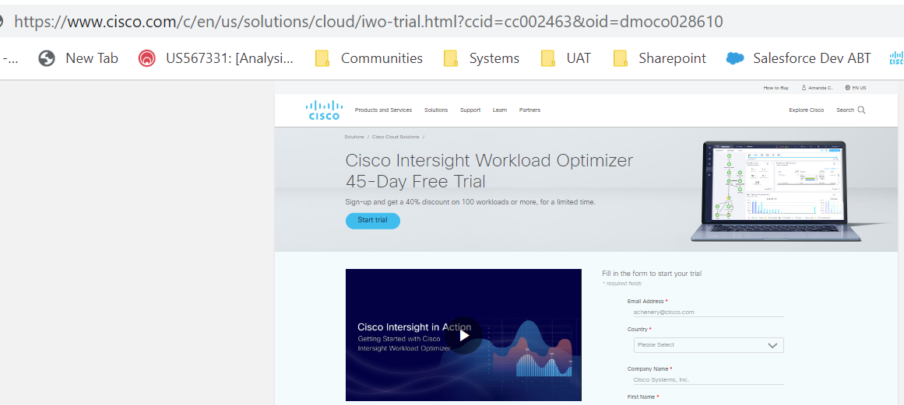
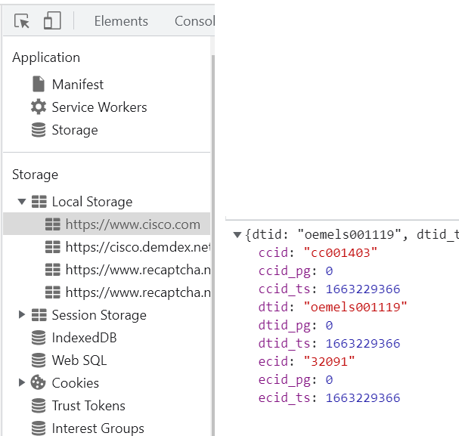


Order of Precedence – ctm.js
First
Last
URL Query String
Local Storage
Form Fill in Landing Page
Page CCID Logic
If you have a CTT ID in your URL String – Pass the last one captured as the Last Touch Activity
If the CTT ID is not found in any URL, check to see if the contact has been on Cisco.com in the last 24 hours and what was the last CTT ID that they came across and capture that ID as the Last Touch Activity
If we have no ID from a URL and there is nothing in the local storage – we will look at the landing page of the form and see if there is an ID there (These are selected in your form DCD) and this will be sent as the Last Touch Activity
If we have no CCID captured in any of the previous areas – we will try and derive the CCID from logic aligned to the product page
Notes:
Today we use Omni channel IDs for multiple different reason. We use it to try and calculate return on investment by decorating internal pages with IDs. They used they are used to inform processes in downstream systems, such as defined business categories, routing and aligning outreach sequences to drive the LDRs conversation. We also look at IDs for measuring performance and how well, activities offers and channels are working
On all our Web pages, we have Java script, and the Java script is looking to find the best place to find the corresponding Omni channel IDs. The 1st place that we look is within the URL of the query string for specific trigger ids &ccid= etc. if the ID is found in this specific format, we write the data to local storage and keep that ID to pass downstream until if finds another ID in a URL.
If there are no IDs in the query string, we will look at the local storage when someone comes onto Cisco.com they are given the option to store cookies at that point. If they are accepting that information, we will store the latest Omni channel information in their local storage.
If we have no information in either the URL query string or in the local storage, we will look at the form fill in the landing page. When setting up your DCDs, you'll be aligning your IDs onto the landing page.
As a last resort, if none of the Omni channel ideas can be found in any of the previous places, we have some logic to try and work out the correct activity ID determined by the product page that you were last on

Slide 10





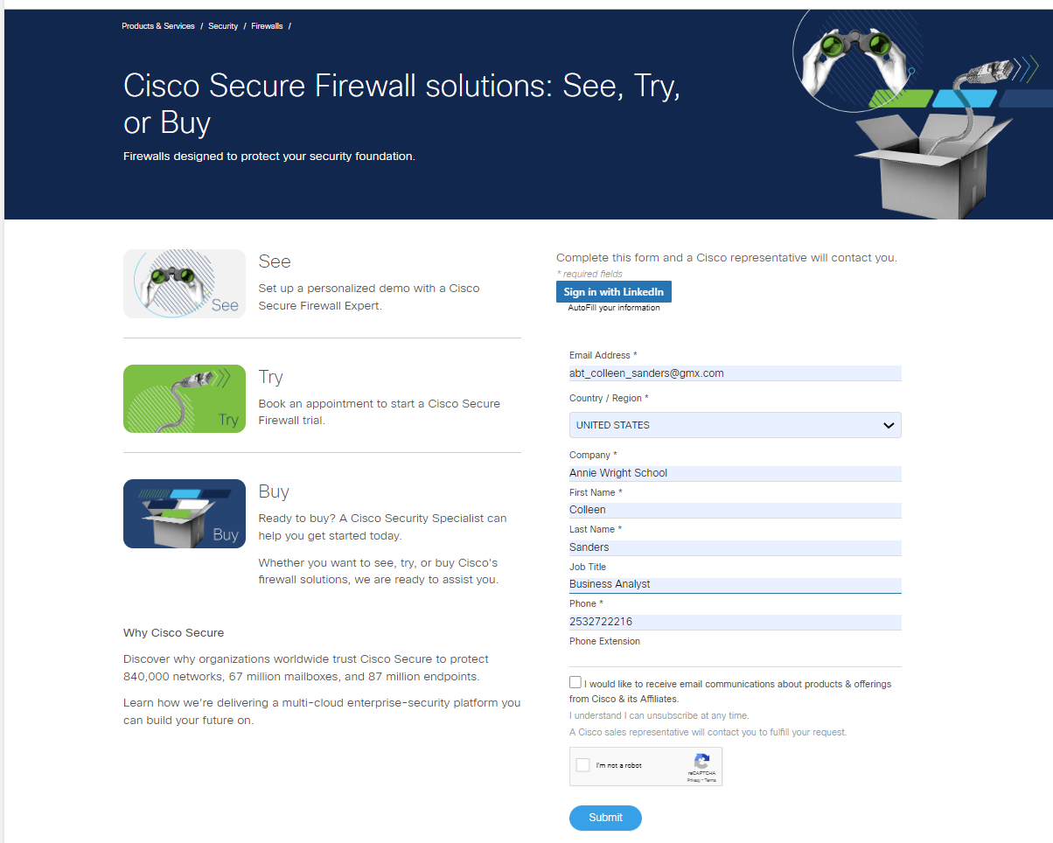

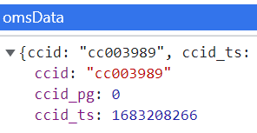
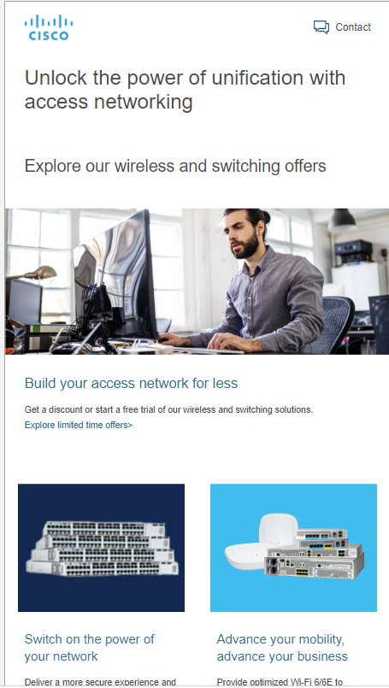

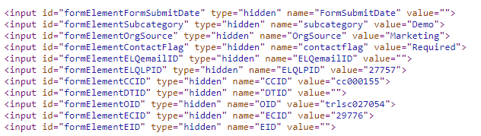
Customer Journey Example - Today
https://www.cisco.com/c/en/us/solutions/enterprise-networks/promotions-free-trials.html
Activity ID
https://www.cisco.com/c/en/us/solutions/enterprise-networks/promotions-free-trials/networking-remanufactured-equipment.html?
Local Storage
cc003989
Cisco Meraki Webinar for SMB 23
Power Hybrid Work
https://www.cisco.com/site/us/en/products/networking/sdwan-routers/catalyst-8000-edge-platforms/index.html
https://www.cisco.com/site/us/en/solutions/secure-the-enterprise/index.html
Offer ID
Page
trlsc027054
Cisco Secure Firewall Free Trial Security
Secure the Enterprise
https://www.cisco.com/site/us/en/products/security/firewalls/index.html
https://www.cisco.com/c/en/us/products/security/firewalls/get-started.html?dtid=odicdc000509
https://www.cisco.com/c/en/us/solutions/enterprise-networks/promotions-free-trials.html?dtid=oemels001119&ecid=32864#~wireless-and-switching
Drive To ID
URL
odicdc000509
Owned - Display - Cisco.com

Slide 11
Customer Journey Example – Lead Generating Tomorrow
https://www.cisco.com/c/en/us/solutions/enterprise-networks/promotions-free-trials.html
Activity ID
https://www.cisco.com/c/en/us/solutions/enterprise-networks/promotions-free-trials/networking-remanufactured-equipment.html?oid=otretr026244
URL
cc001400
Secure Access - IBN Americas
Transform Infrastructure
https://www.cisco.com/site/us/en/products/networking/sdwan-routers/catalyst-8000-edge-platforms/index.html
https://www.cisco.com/site/us/en/solutions/secure-the-enterprise/index.html
Offer ID
Landing Page
trlsc027054
Cisco Secure Firewall Free Trial Security
Secure the Enterprise
https://www.cisco.com/site/us/en/products/security/firewalls/index.html
https://www.cisco.com/c/en/us/products/security/firewalls/get-started.html?ccid=cc000155&dtid=odicdc000509&oid=trlsc027054
https://www.cisco.com/c/en/us/solutions/enterprise-networks/promotions-free-trials.html?team=digital_marketing&medium=email&campaign=transform_infrastructure&ccid=cc001400&dtid=oemels001119
Drive To ID
URL
oemels001119
Owned - Email - Eloqua Campaign Emails

Slide 12


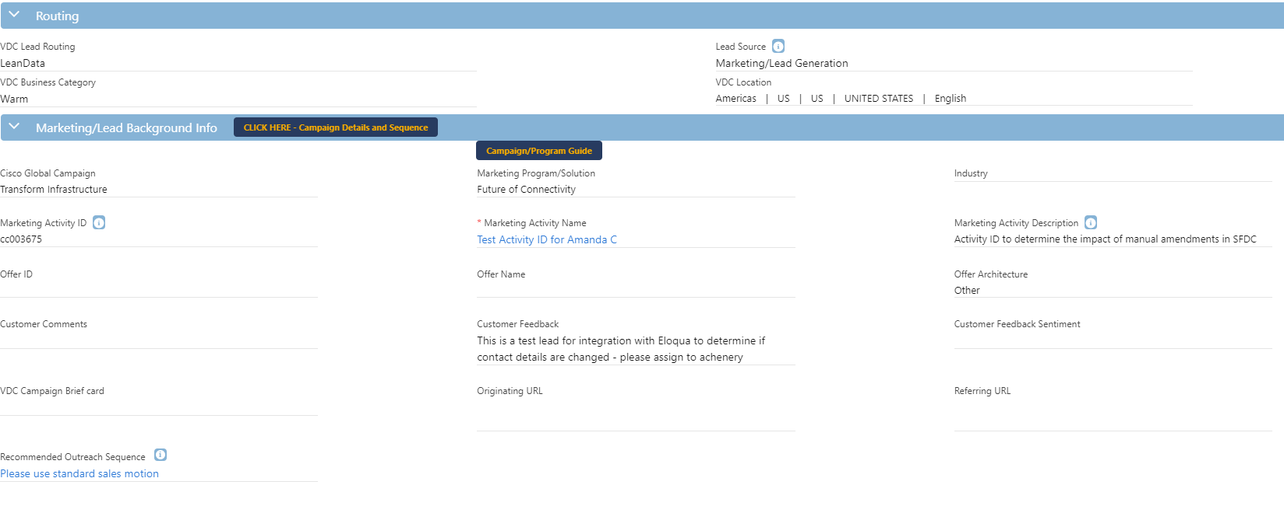



Legend
Manual
Lead Creation
Automated
Marketing Team
DART Team
1 – Intake Tools
2 – Tray.io
3 - SFDC
CCID Mandatory
DTID Mandatory (Coming)
Offer iD Optional
Campaigns
Data Fields
Activity ID
Activity Name
Activity Description
Offer ID
Offer Name
Offer Description
Drive To ID
Drive To Channel
Campaign
Program
Live Dates
Lead added
Campaign Member Added
CCID Optional
DTID Optional
Offer ID Optional
CCID Mandatory Field to create a Lead
Leads
VDC Console
Marketing Activity ID
Activity ID Description
Activity ID aligned to Salesforce Campaign
Offer ID
Offer Name
CCID Mandatory
DTID Optional
Offer ID Optional
Logic
Data Validations on CTT ID on incoming records
CTT Integration to add additional attributes
Logic using DTID to define tagging channels and Business Category
Architecture (but currently being removed)
CCID Mandatory
DTID Mandatory
Offer ID Mandatory
SFDC Integration with CTT
Cisco Global Campaign
Marketing Program Solution
Industry
All values are defaulted in Tray.io as a standard process
SFDC Reporting
All VDC Console Fields
Drive To ID

Slide 13
Tray Processing
Data Attributes Example
Activity ID
cc002657
Program ID
Activity Name
Full-Stack Observability - AMER - FY21
Program Name
Description
Full-Stack Observability - AMER
Program Description
OID
dmocsm029414
Offer ID
Offer Name
Cross Arch FSO Free Trials SOLP Demo FY22Q4
Offer Name
Description
Combined free trial form for FSO
Offer Description
DTID
pseggl000015
Drive To ID
Vehicle Name
Paid Search
Drive to Channel Name
N/A Derived from Vehicle Name
Web
Tagging Channel

Slide 14
Salesforce Lead Generation –VDC Console
Data Attributes Example
Campaign (CCID)
Secure the Enterprise
Cisco Global Campaign
Program (CCID)
Firewall
Marketing Program/Solution
Intended Vertical (OID)
Manufacturing
Industry
Program ID (Tray)
cc003783
Marketing Activity ID
Activity Name (CCID)
Paid Leads: Cisco Secure Firewall Appointments Qualified by Rombii
Marketing Activity Name
Program Description (Tray)
This activity will engage trending accounts engaging with Firewall topics; with the opportunity to speak with intelligence regarding Firewall
Marketing Activity Desc
Offer ID (Tray)
satsc030090
Offer ID
Offer Name (Tray)
Security - Customer- Rapid Resilience Appointments - Network Security - Sales Appointment 23
Offer Name
Business Entity (OID)
Security
Offer Architecture

Slide 15
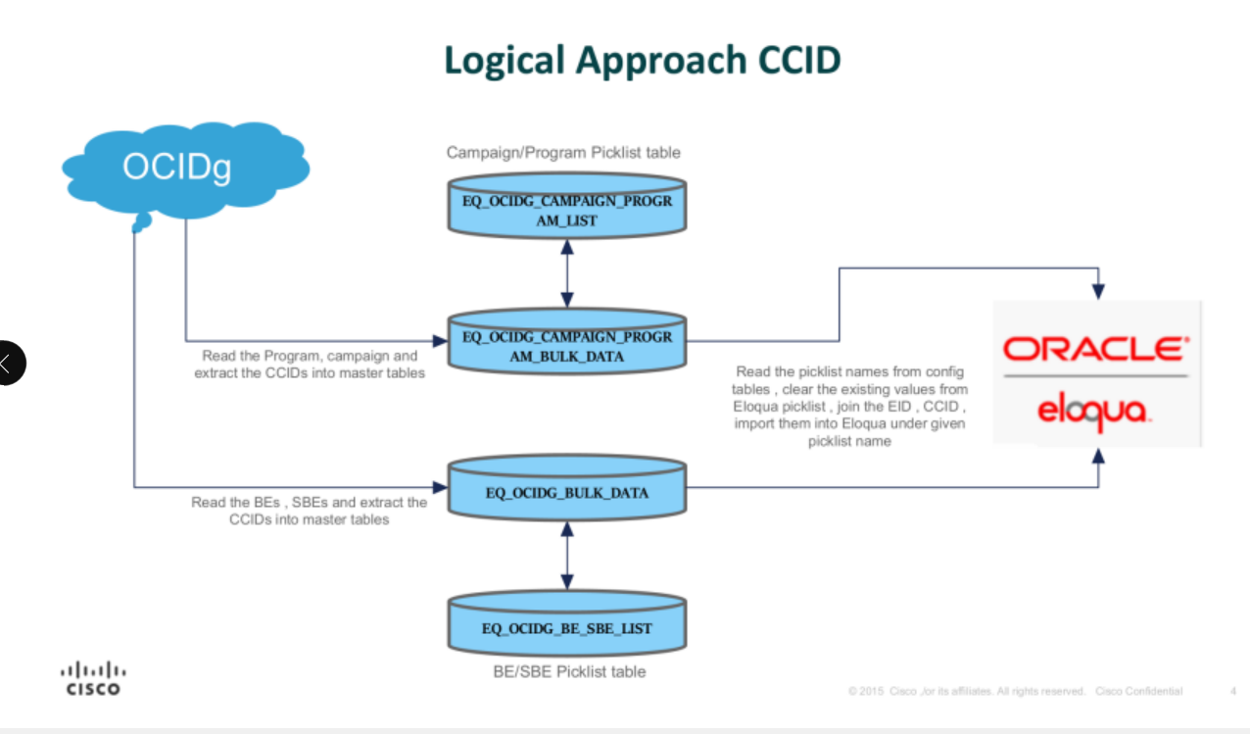
Eloqua Picklists for AOJs

Slide 16

Eloqua Always on Journeys –Need to work on this one
Data Attributes Example
Campaign (CCID)
Secure the Enterprise
Cisco Global Campaign
Program (CCID)
Firewall
Marketing Program/Solution
Intended Vertical (OID)
Manufacturing
Industry
Program ID (Tray)
cc003783
Marketing Activity ID
Activity Name (CCID)
Paid Leads: Cisco Secure Firewall Appointments Qualified by Rombii
Marketing Activity Name
Program Description (Tray)
This activity will engage trending accounts engaging with Firewall topics; with the opportunity to speak with intelligence regarding Firewall
Marketing Activity Desc
Offer ID (Tray)
satsc030090
Offer ID
Offer Name (Tray)
Security - Customer- Rapid Resilience Appointments - Network Security - Sales Appointment 23
Offer Name
Business Entity (OID)
Security
Offer Architecture

Slide 17
Eloqua Global Form Standardisation – Landing Page Metadata –Need to work on this one
Data Attributes Example
Campaign (CCID)
Secure the Enterprise
Cisco Global Campaign
Program (CCID)
Firewall
Marketing Program/Solution
Intended Vertical (OID)
Manufacturing
Industry
Program ID (Tray)
cc003783
Marketing Activity ID
Activity Name (CCID)
Paid Leads: Cisco Secure Firewall Appointments Qualified by Rombii
Marketing Activity Name
Program Description (Tray)
This activity will engage trending accounts engaging with Firewall topics; with the opportunity to speak with intelligence regarding Firewall
Marketing Activity Desc
Offer ID (Tray)
satsc030090
Offer ID
Offer Name (Tray)
Security - Customer- Rapid Resilience Appointments - Network Security - Sales Appointment 23
Offer Name
Business Entity (OID)
Security
Offer Architecture

Slide 18
Offer ID Processes and Tools
APIs (Tray, Allocadia, Eloqua, VDC Tools)
Create SFDC Campaigns (not currently used)
Visibility to LDR of Offer Name and Description
Tray processing flows
Free Trial Processing and Follow-up in Tray
Landing Page Metadata
Ctm.js logic
Validated field for manual upload process
Optional field for event integrations
Data attributes captured in CDF and ADF – Unknown Impact

Slide 19
Drive To ID Processes and Tools
APIs (Tray, Allocadia, Eloqua, VDC Tools)
Tray processing flows
Ctm.js logic
Validated field for manual upload process
Derive Business Category in Tray
Mandatory field in Manual Uploads (coming)
Data attributes captured in CDF and ADF – Unknown Impact

